Slide 1


Connect with me
Twitter: @MrThomasRayner
LinkedIn.com/in/thomasrayner
workingsysadmin.com
Slides and Demo Script
https://github.com/ThmsRynr/Presentation-Files

Slide 2
A word on scope
Deployment models
Classic
Resource Manager
CLI interfaces
Azure Cloud Shell
PowerShell
Bash
Azure CLI
AzureRM PowerShell Module
Each of these has strong use cases and scenarios that make it worth learning and using!

Slide 3
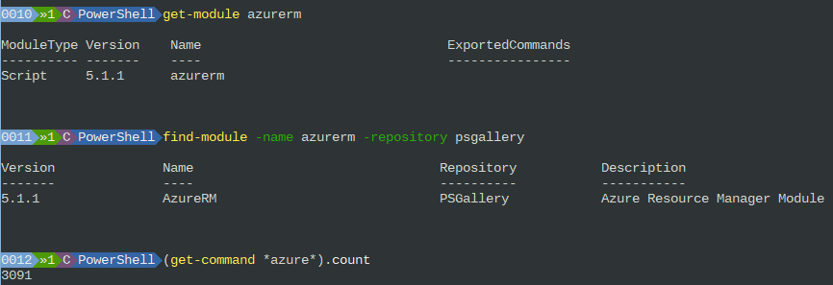
My environment

Slide 4
Round 1: Logging In

Slide 5
Scoreboard
It’s just logging in…
Web Portal
PowerShell
0
0

Slide 6
Round 2: Routine tasks at 4 AM

Slide 7
Scoreboard
Azure’s always awake… do you want to be, too?
Web Portal
PowerShell
0
1
0

Slide 8
Round 3: Create one new resource group

Slide 9
Scoreboard
There’s a PowerShell module for everything
Web Portal
PowerShell
1
0
1

Slide 10
Round 4: Create ten new resource groups

Slide 11
Scoreboard
Doing less pointy-clicky means you get to do more interesting and fun
Web Portal
PowerShell
1
2
1

Slide 12
Lessons Learned
You don’t need incredible PowerShell prowess to use the AzureRM PowerShell module
Repetitive tasks are generally well-suited for automation
The web portal is easy to explore
These are all just tools in your toolbox – use the best one for the job

Slide 13
Connect with me
@MrThomasRayner
LinkedIn.com/in/thomasrayner
workingsysadmin.com

